Slide 1
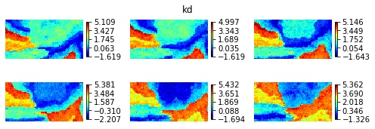
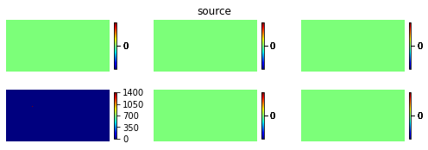
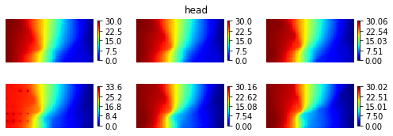
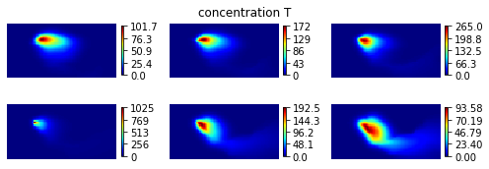
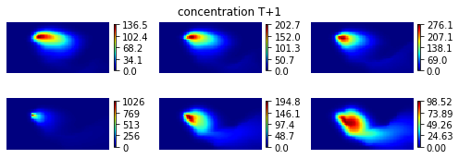
Autoregressive
model

Slide 3
encoder
decoder
Latent var
z: 924*1

Slide 4
Reference
Ensemble mean
Ensemble variance
Posterior sample 1
Posterior sample 2
Posterior sample 3

Slide 5
Reference
Ensemble mean
Ensemble variance
Posterior sample 1
Posterior sample 2
Posterior sample 3
This is with the data generated with NN model

Slide 7
Reference
Ensemble mean
Ensemble variance
Posterior sample 1
Posterior sample 2
Posterior sample 3
This is with the data generated with real physical model

